Slide 1
CRYPTOGRAPHICS TOOLS
CHAPTER 6

Slide 2
Learning outcome
LO 1 : Define basic principal of computer security

Slide 3
Subtopics
Symmetric encryption
DES (Data encryption standard) and AES (Advance encryption standard)
Practical Security Issues
Block and Stream Chipers
Message Authentication
Hash Function
Kerberos
Certificate Authority (CA)
X.509
Public Key Encryption Random Numbers

Slide 4


#ProtectTheNation

Slide 5
CRYPTOGRAPHICS TOOLS
cryptographic algorithms important element in security services
review various types of elements
  symmetric encryption
  public-key (asymmetric) encryption
  digital signatures and key management
  secure hash functions
example is use to encrypt stored data

Slide 6
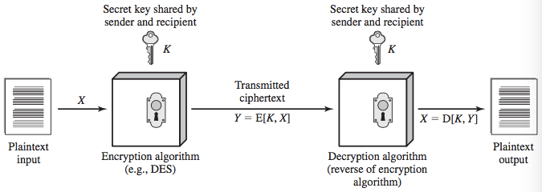
SYMMETRIC ENCRYPTION

Slide 7
ATTACKING SYMMETRIC ENCRYPTION
cryptanalysis
  rely on nature of the algorithm
  plus some knowledge of plaintext characteristics
  even some sample plaintext-ciphertext pairs
  exploits characteristics of algorithm to deduce specific plaintext or key
brute-force attack
  try all possible keys on some ciphertext until get an intelligible translation into plaintext

Slide 8
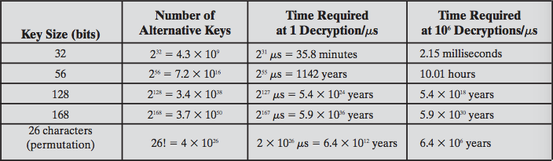
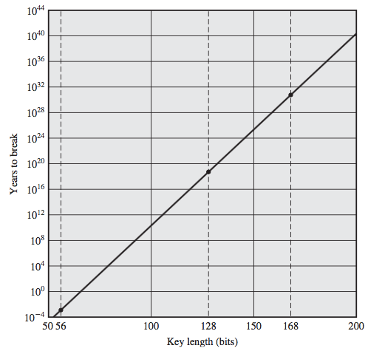
EXHAUSTIVE KEY SEARCH

Slide 9
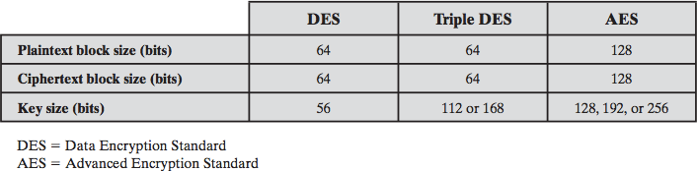
POPULAR SYMMETRIC ENCRYPTION

Slide 10
DES AND TRIPLE-DES
Data Encryption Standard (DES) is the most widely used encryption scheme
  uses 64 bit plaintext block and 56 bit key to produce a 64 bit ciphertext block
  concerns about algorithm & use of 56-bit key
Triple-DES
  repeats basic DES algorithm three times
  using either two or three unique keys
  much more secure but also much slower

Slide 11
ADVANCED ENCRYPTION STANDARD
needed a better replacement for DES
NIST called for proposals in 1997
  efficiency, security, HW/SW suitability, 128, 256, 256 keys
selected Rijndael in Nov 2001
symmetric block cipher
uses 128 bit data & 128/192/256 bit keys
now widely available commercially

Slide 12
PRACTICAL APPLICATION: ENCRYPTION OF STORED DATA
common to encrypt transmitted data
much less common for stored data
  which can be copied, backed up, recovered
approaches to encrypt stored data:
  back-end appliance (hardware device close to data storage; encrypt close to wire speed)
  library based tape encryption (co-processor board embedded in tape drive)
  background laptop/PC data encryption

Slide 13
Block cipher encryption
A block cipher uses a symmetric key and algorithm to encrypt and decrypt a block of data
A block cipher requires an initialization vector (IV) that is added to the input plaintext in order to increase the keyspace of the cipher
The IV is derived from a random number generator, which is combined with text in the first block and the key to ensure all subsequent blocks

Slide 14
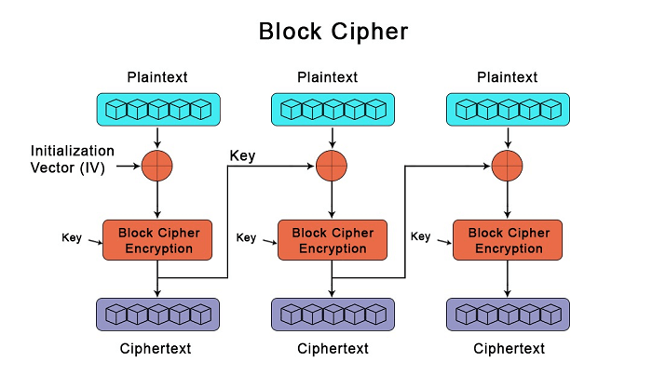
Block cipher encryption

Slide 15
Stream cipher encryption
protects against active attacks
verifies received message is authentic
  contents unaltered
  from authentic source
  timely and in correct sequence
can use conventional encryption
  only sender & receiver have key needed
or separate authentication mechanisms
  append authentication tag to cleartext message

Slide 16
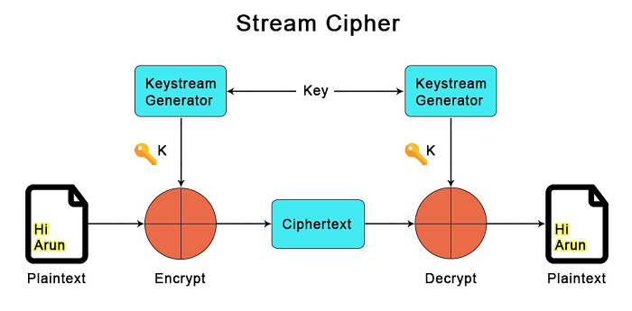
Stream cipher encryption

Slide 17
Message authentication
one way to prevent active attacks is to use authentication
A message, file, document, or other collection of data is said to be authentic when it is genuine and came from its alleged source.
The two important aspects are to verify that the contents of the message have not been altered and that the source is authentic

Slide 18
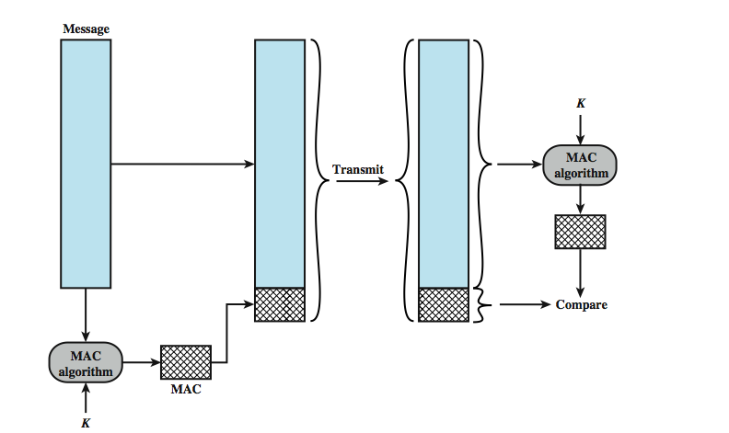
Message authentication codes

Slide 19
HASH FUNCTION REQUIREMENT
applied to any size data
H produces a fixed-length output.
H(x) is relatively easy to compute for any given x
one-way property
computationally infeasible to find x such that H(x) = h
weak collision resistance
  computationally infeasible to find y ≠ x such tha H(y) = H(x)
strong collision resistance
  computationally infeasible to find any pair (x, y) such that H(x) = H(y)

Slide 20
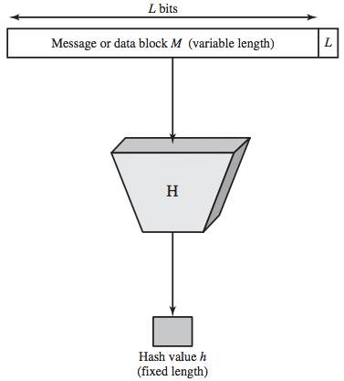
SECURE HASH FUNCTION

Slide 21
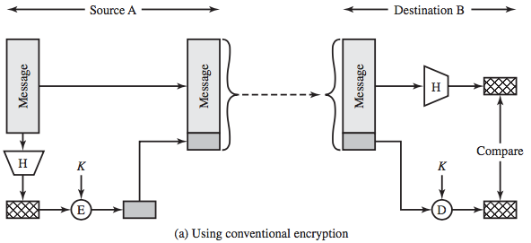
HASH FUNCTION CONVENTIONAL ENCRYPTION

Slide 22
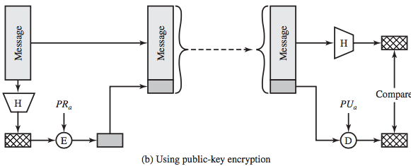
HASH FUNCTION PUBLIC KEY ENCRYPTION

Slide 23
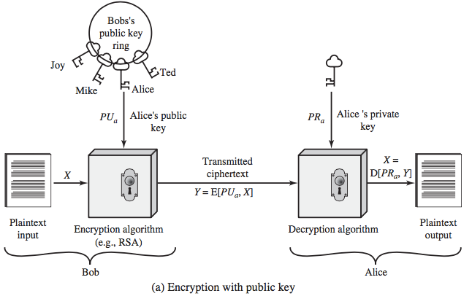
PUBLIC KEY ENCRYPTION

Slide 24
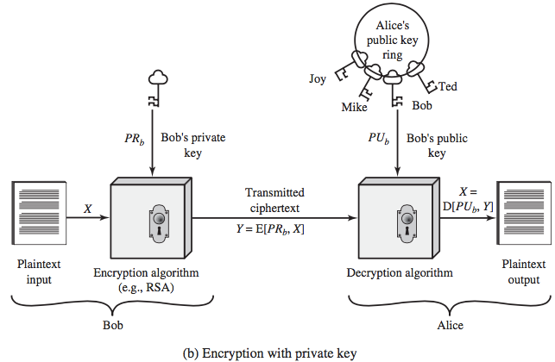
PUBLIC KEY AUTHENTICATION

Slide 25
PUBLIC KEY REQUIREMENTS
computationally easy to create key pairs
computationally easy for sender knowing public key to encrypt messages
computationally easy for receiver knowing private key to decrypt ciphertext
computationally infeasible for opponent to determine private key from public key
computationally infeasible for opponent to otherwise recover original message
useful if either key can be used for each role

Slide 26
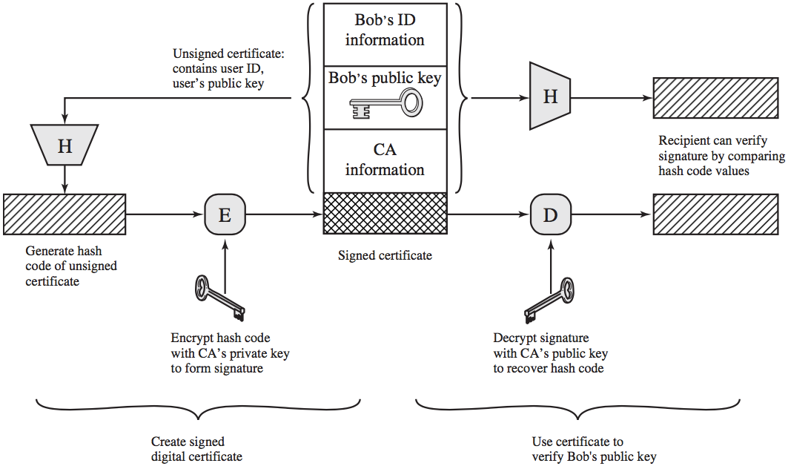
PUBLIC KEY CERTIFICATE

Slide 27
kerberos
Kerberos makes use of a protocol that involves clients, application servers, and a Kerberos server
Kerberos is designed to counter a variety of threats to the security of a client/server dialogue
Kerberos has been issued as an Internet standard and is the de facto standard for remote authentication

Slide 28
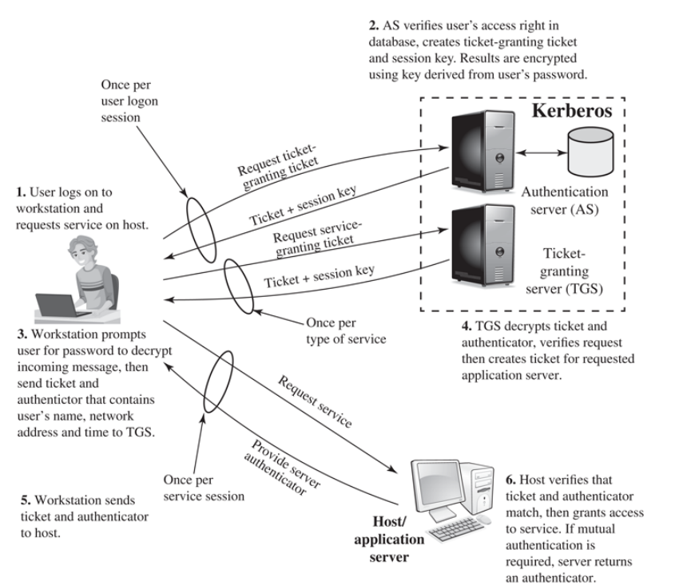
Kerberos overview

Slide 29
Certificate Authority
Trusted third-party organization that issues digital certificates for use by other parties to establish secure encrypted connections
The role of a CA is to verify the identity of a party requesting a certificate, and then to issue a certificate attesting to the identity of that party
parties can trust that they are communicating with the intended recipient and not an impostor

Slide 30
x.509
X.509 is an ITU-T standard for public key infrastructure (PKI) that defines the format of public key certificates
X.509 certificates are widely used for secure web browsing (HTTPS), secure email (SMIME), and secure virtual private networks (VPNs).

Slide 31
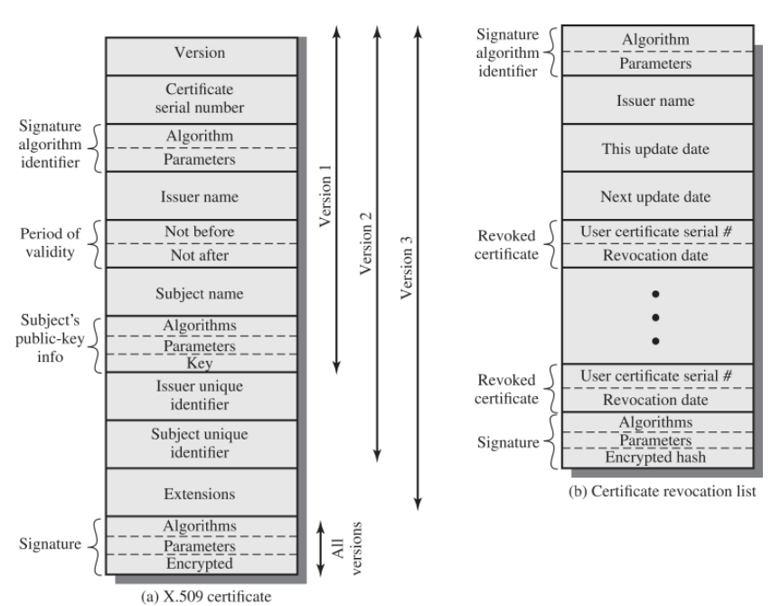
x.509

Slide 32
Public key encryption random numbers
Public key encryption random numbers are numbers that are generated randomly and used as input in public key encryption algorithms
ensure the security and confidentiality of encrypted communications by preventing patterns and biases in encryption data

Slide 33
Public key encryption random numbers requirements
Randomness​
based on statistical tests for uniform distribution and independence​
Unpredictability​
successive values not related to previous​
clearly true for truly random numbers​
Generation speed
random numbers must be generated quickly to ensure real-time encryption and decryption

Slide 34
Public key encryption random numbers requirements
Quality​
random numbers must be generated from a high-quality random number generator to ensure their entropy and randomness​
Availability​
random numbers must be available at the time they are needed, without delay

Slide 35
references
https://static.javatpoint.com/difference/images/difference-between-block-cipher-and-stream-cipher.png
https://static.javatpoint.com/difference/images/difference-between-block-cipher-and-stream-cipher2.png

